Slide 1
Transitions
Type
Timing
Forwards AND backwards
Logic

Slide 2


Slide 3
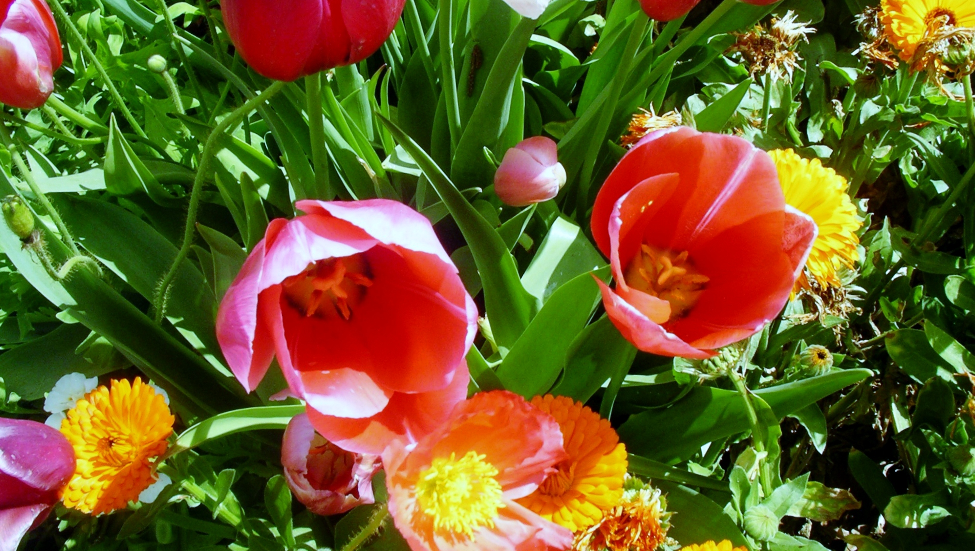

Slide 4
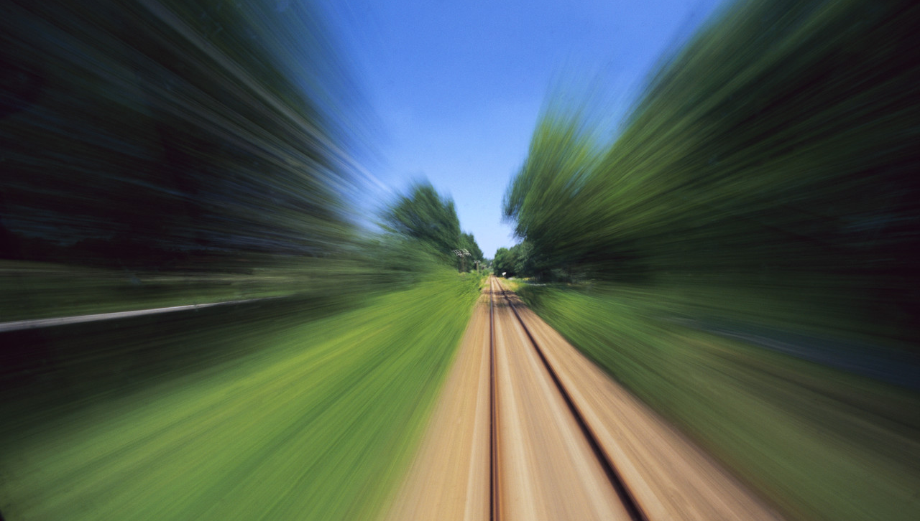

Slide 5


Slide 6
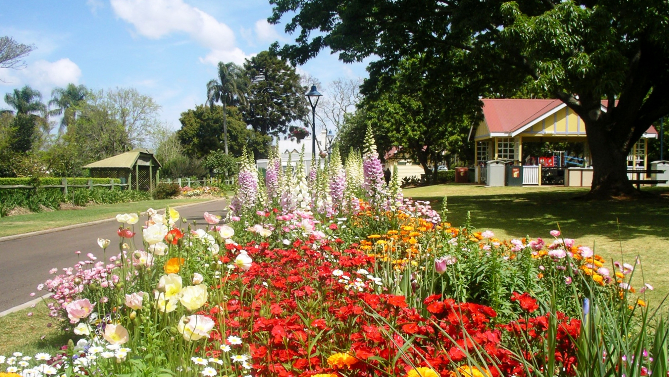

Slide 7
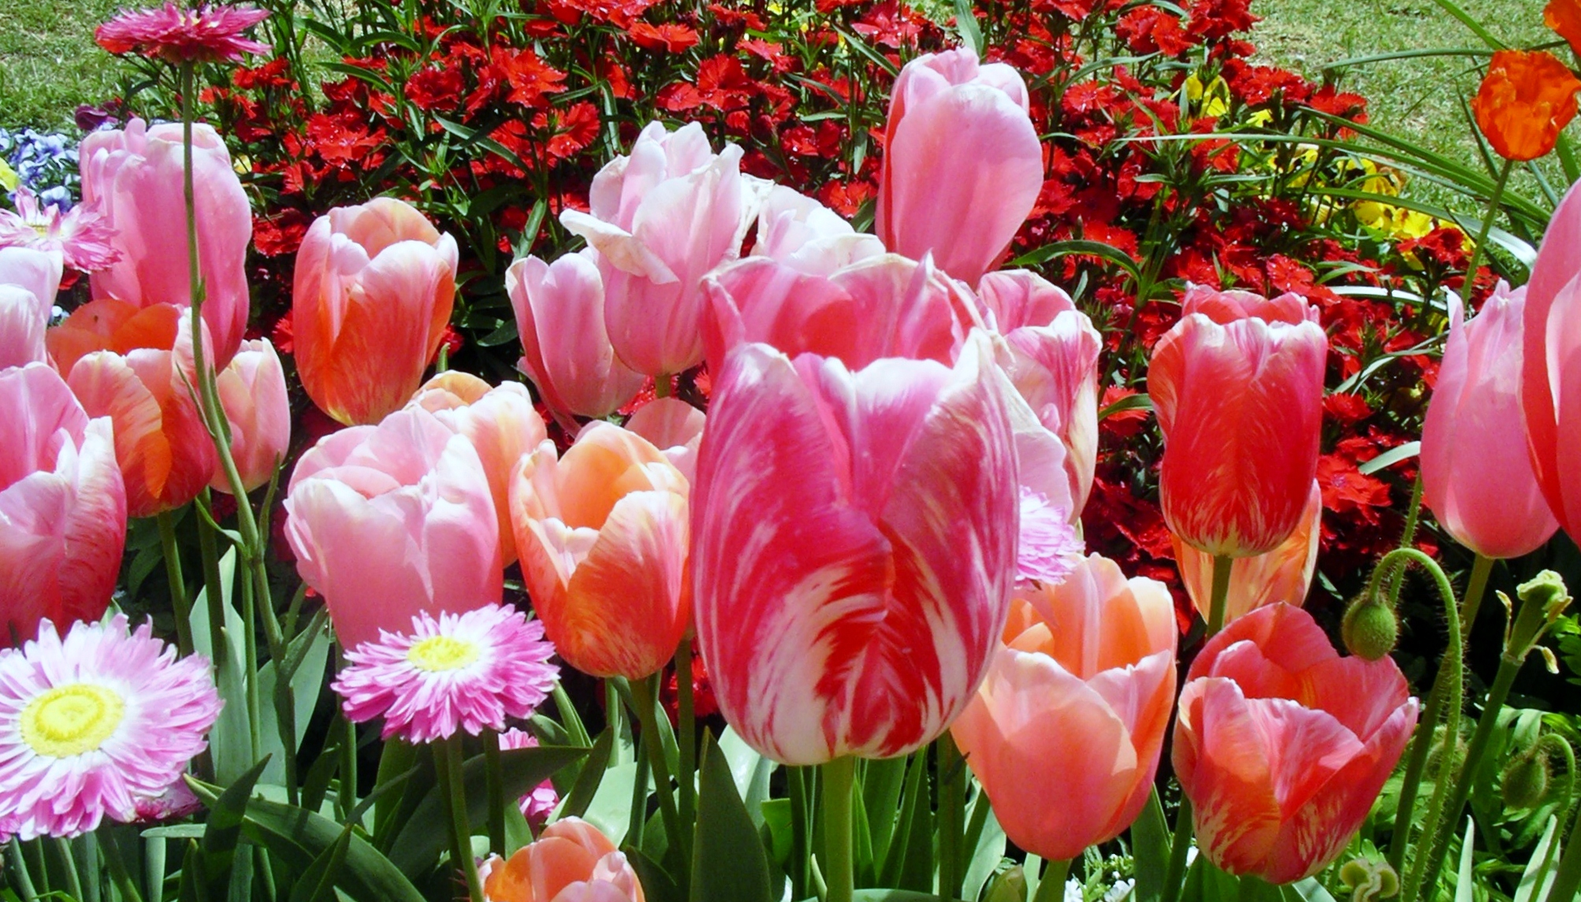

Slide 8
1
2
3

Slide 9
4
5
6

Slide 10
7
8
9

Slide 12


Science in school
leads top science in life

Slide 13
Innovation

Slide 14

Rewards
Increase teacher funding
Increase out of class training
Will increase student participation
And satisfaction with science
As a life-long career

