Slide 1
Get to Know the PowerPoint Interface

Slide 2
The PowerPoint Interface
The PowerPoint Interface consists of the following sections:
The Title Bar
The Ribbon
The Quick Access Toolbar (QAT)
The Slides Pane
The Slide Window
The Status Bar

Slide 3
The Title Bar
Account Information
Minimize, Maximize and Close
Presentation Title
Search Bar

Slide 4
The Ribbon
Tabs
Commands
Groups

Slide 5
The Quick Access Toolbar
The Quick Access Toolbar is a customizable toolbar. Add commands you use frequently.

Slide 6
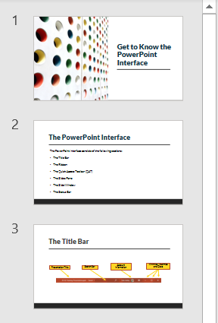
The Slides Pane
The Slides Pane displays thumbnails of all slides in the presentation.
Use the Slides Pane to navigate, select slides and organize the slide deck.

Slide 7
The Slides Window
The Slides Window is where we come to edit our slides.

Slide 8
The Status Bar
The Status bar is a customizable area that runs horizontally across the bottom of the screen.
It displays useful information and messages such as the slide number, the language, notes, magnification and views.

