Slide 1
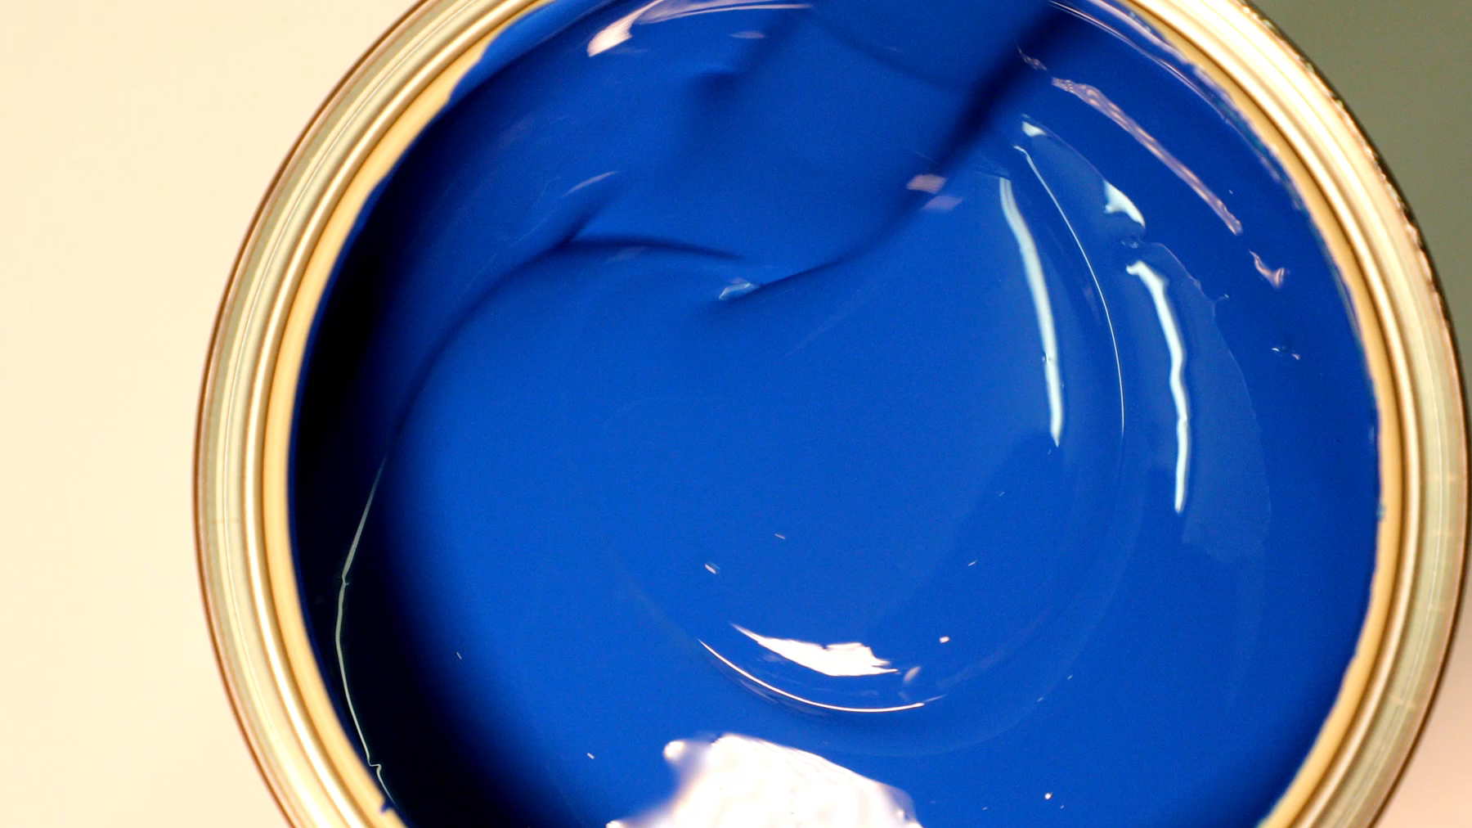
Making Candles at Home
Notes:
Welcome to our presentation about making candles at home. This presentation will provide you with a step-by-step guide on how to get started with candle making.

Slide 2
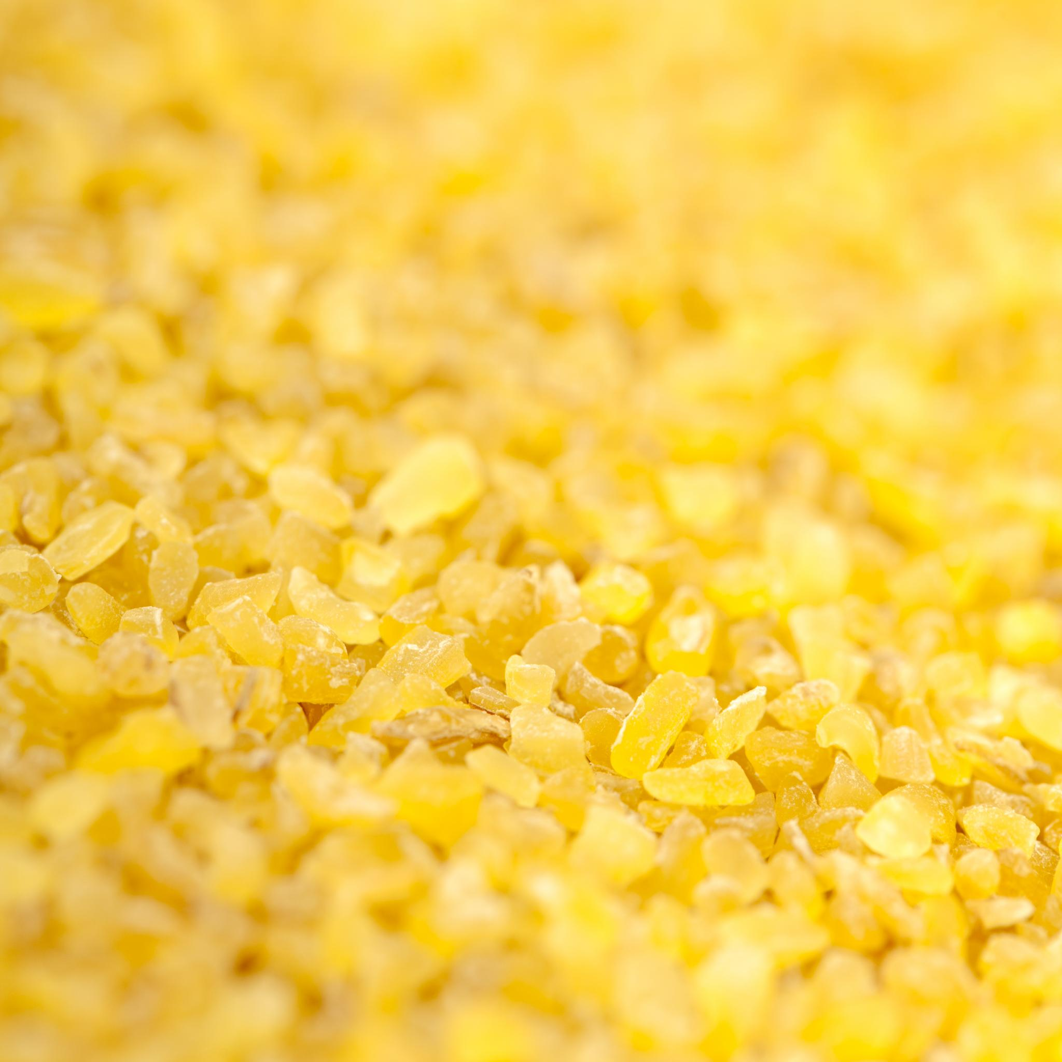
Step 1: Gather Supplies
Gather wax, wicks, a double boiler, and a thermometer
Choose your desired fragrance and color
Notes:
Before you begin making candles, it's important to have all the necessary supplies on hand. Make sure to choose high-quality wax, wicks, and fragrance oils to ensure the best results.

Slide 3
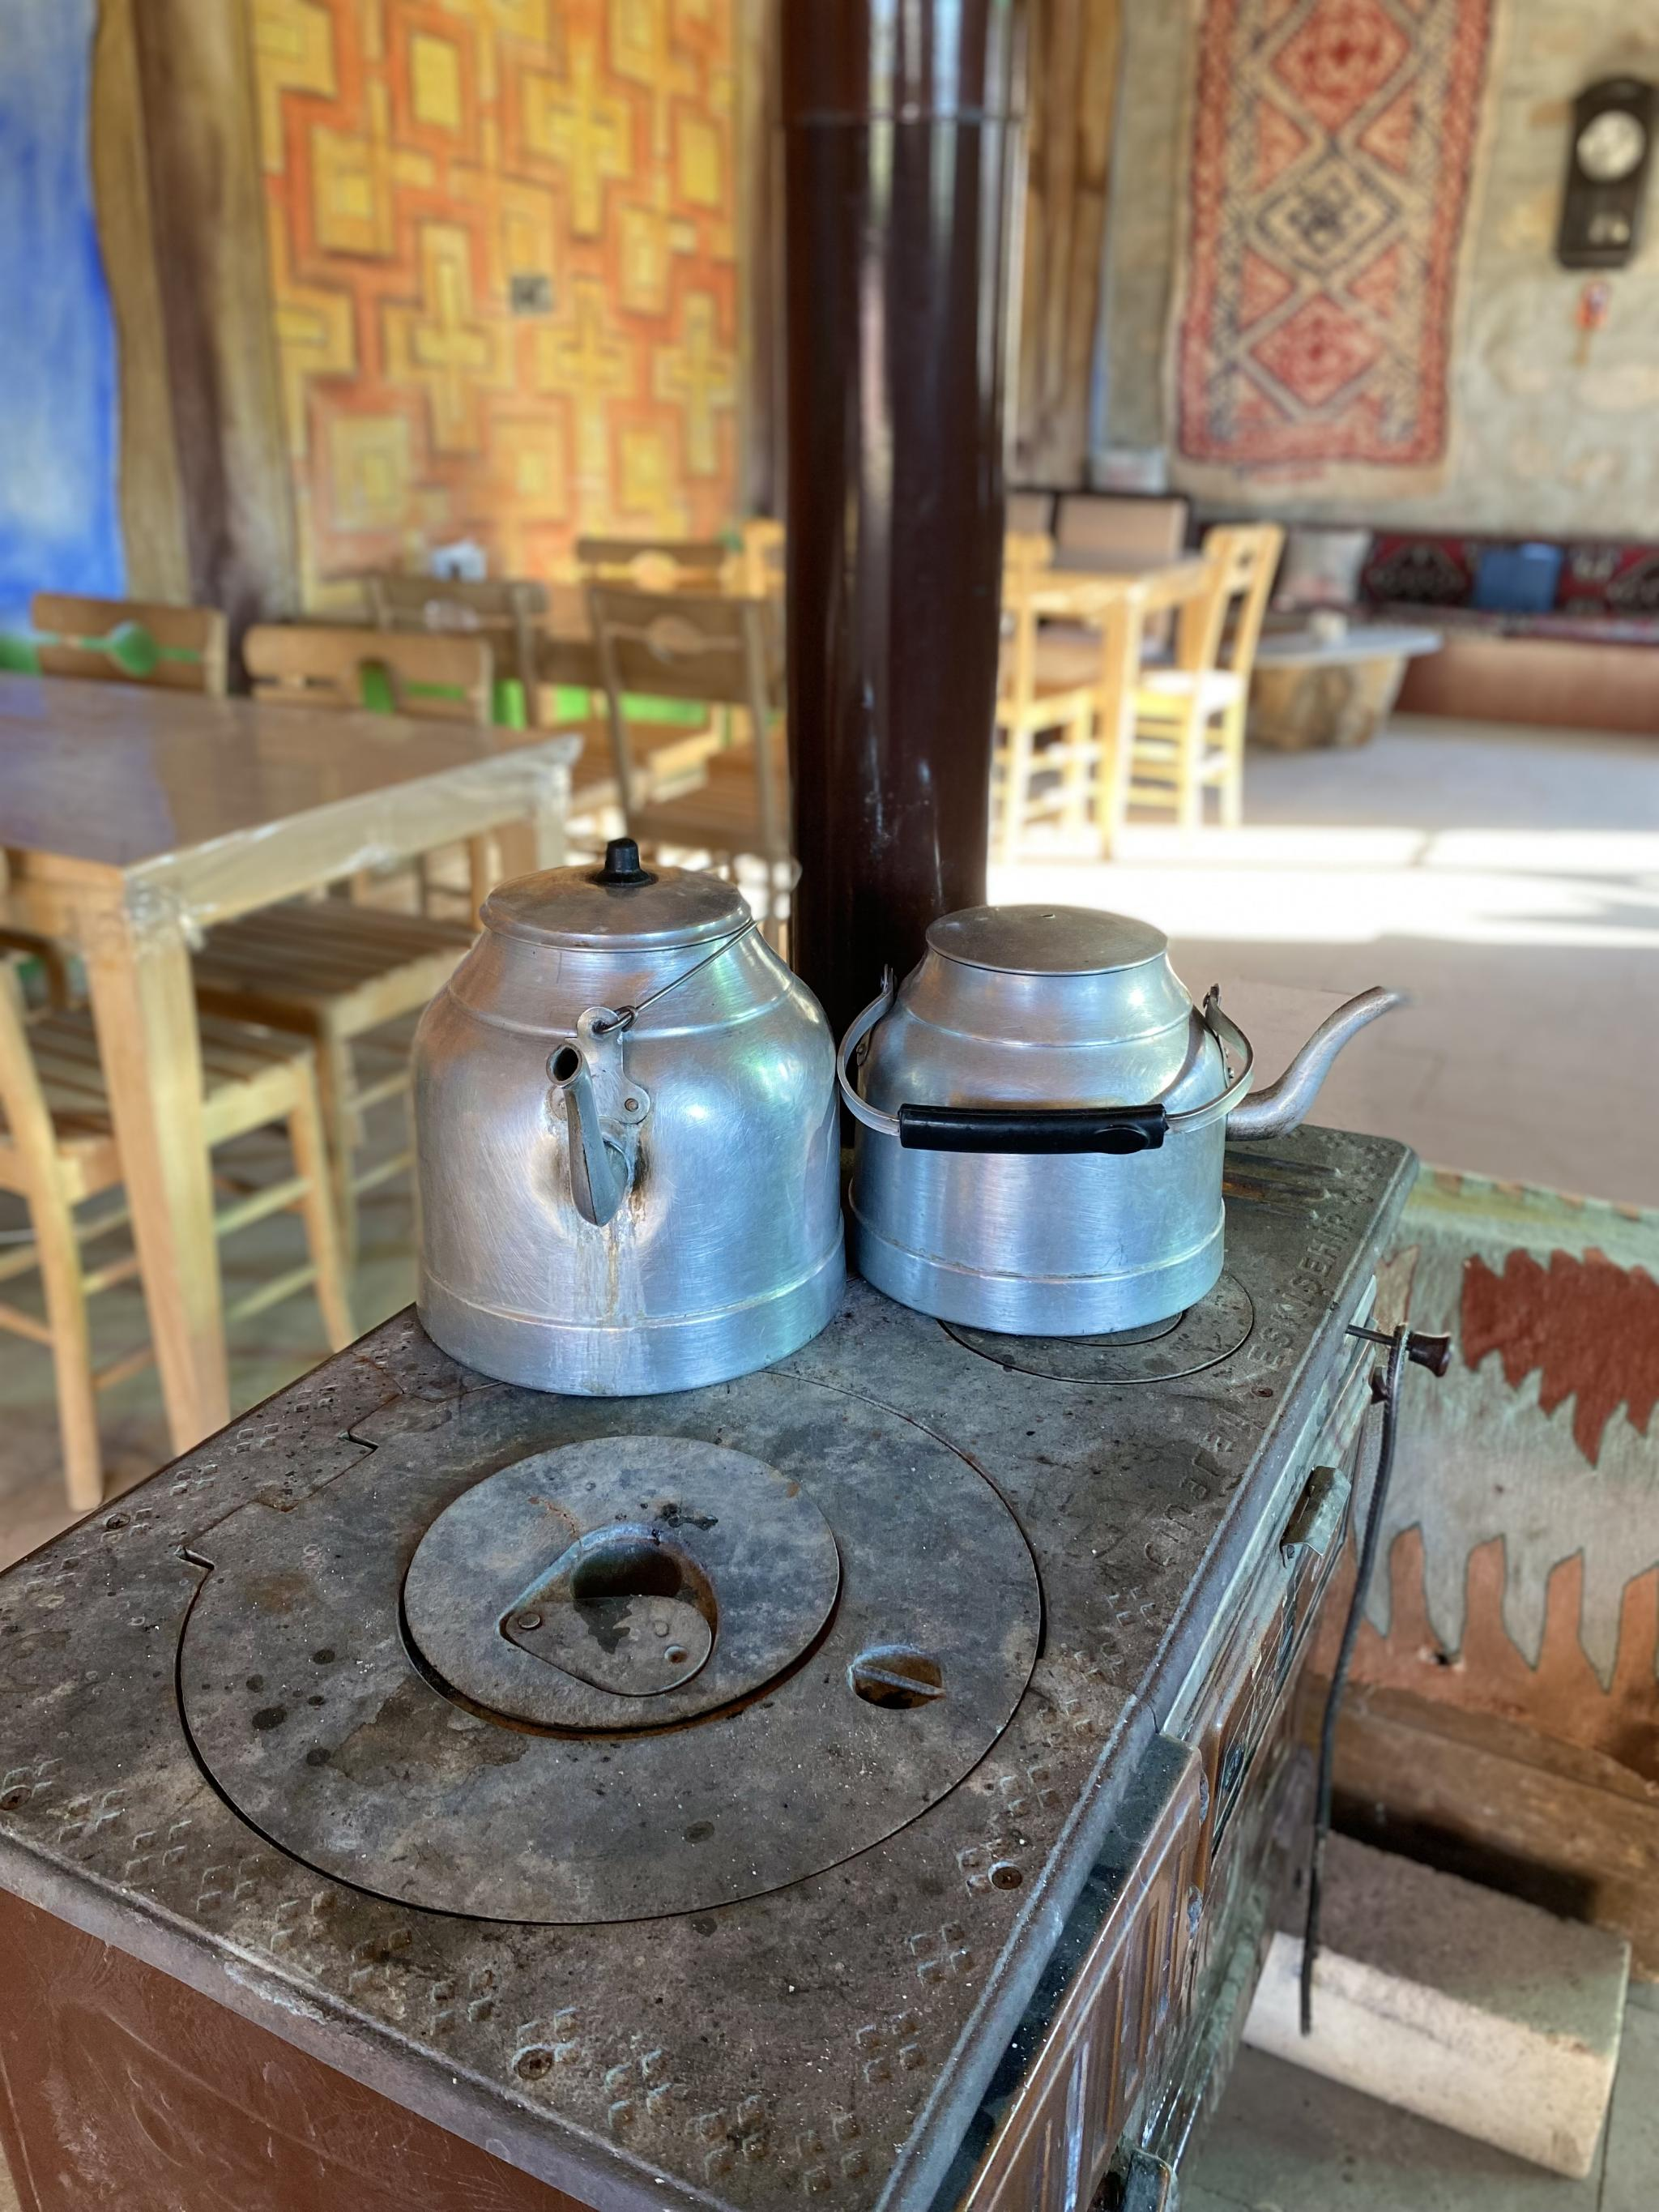
Step 2: Melt the Wax
Melt the wax in a double boiler
Heat to the appropriate temperature
Notes:
Once you have your supplies ready, it's time to start the candle-making process. Begin by melting the wax in a double boiler, and make sure to heat it to the correct temperature according to the type of wax you're using.

Slide 4
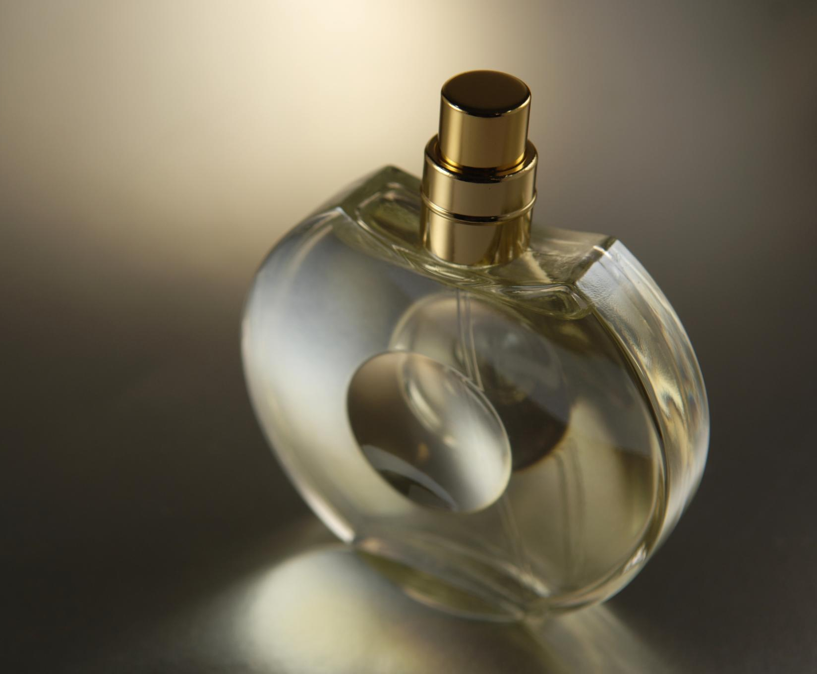
Step 3: Add Fragrance and Color
Add fragrance oil and dye to the melted wax
Stir gently until evenly distributed
Notes:
After the wax has melted, it's time to add the fragrance and color. Make sure to add the fragrance oil and dye slowly and stir gently to ensure that they are evenly distributed throughout the wax.

Slide 5

Step 4: Prepare the Wicks
Cut wicks to the appropriate length
Secure wicks to the bottom of the candle container
Notes:
While the wax is cooling, prepare your wicks. Cut them to the appropriate length, and use a wicking needle to secure them to the bottom of your candle container.

Slide 6
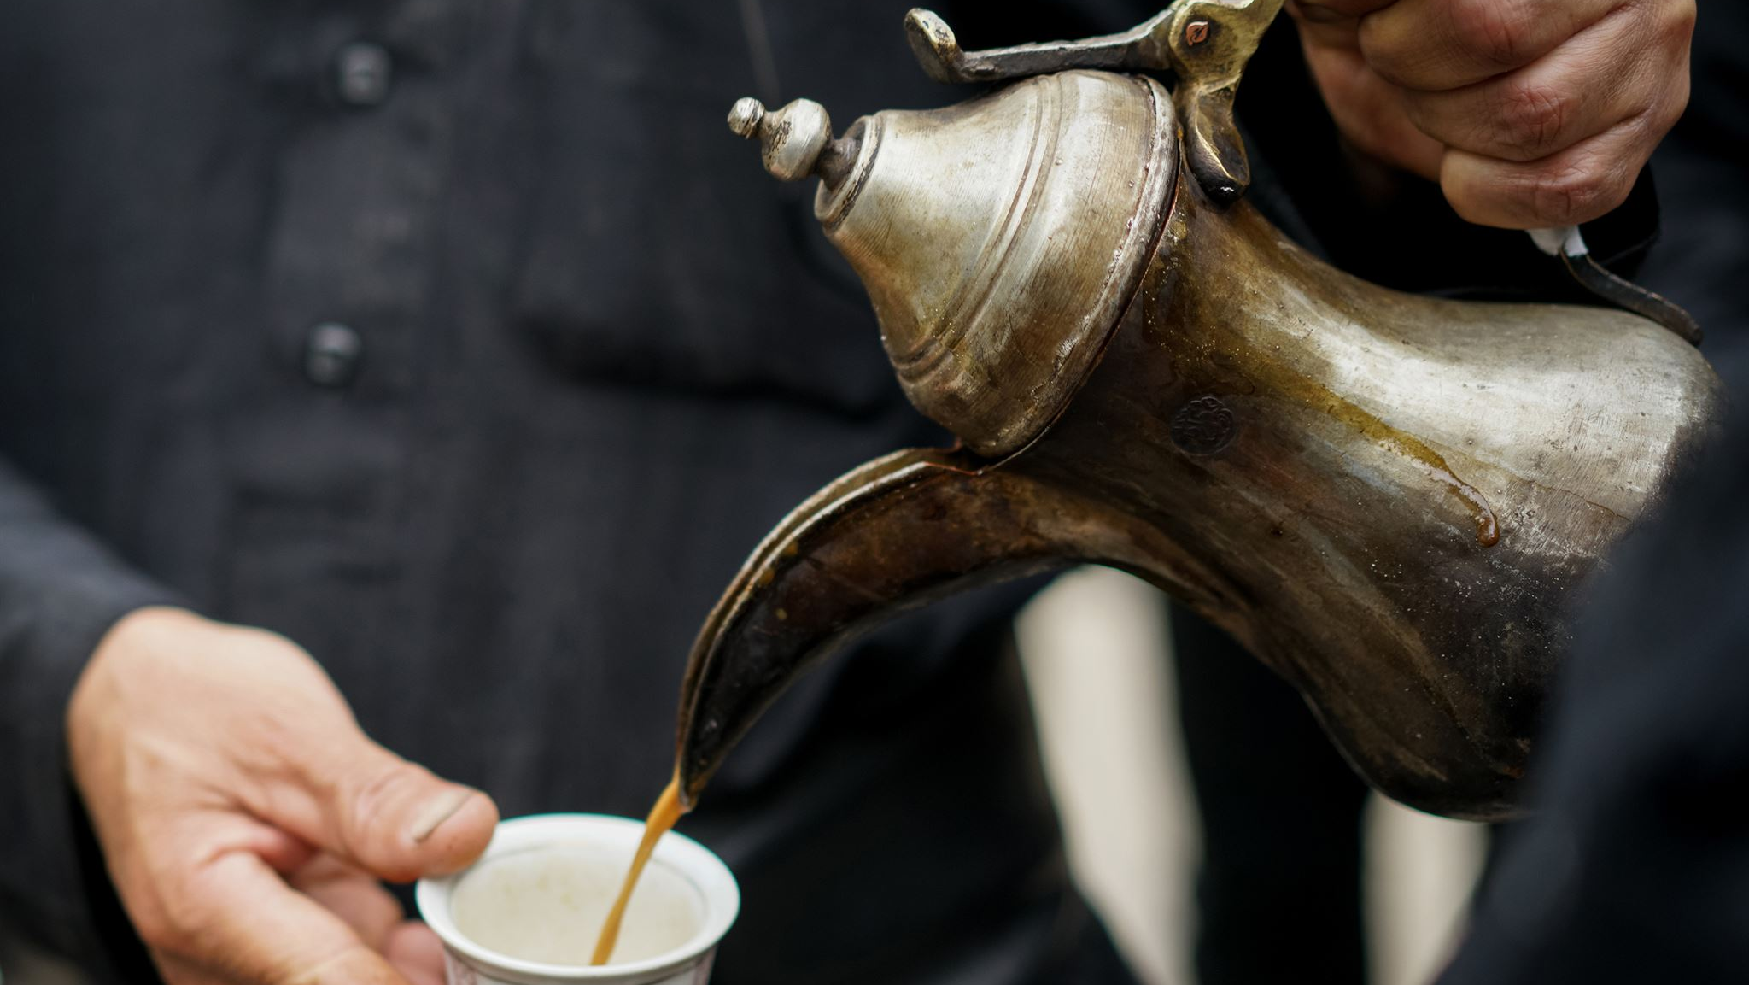
Step 5: Pour the Wax
Slowly pour the wax into the candle container
Leave a small amount of space at the top
Notes:
When the wax has cooled to the appropriate temperature, it's time to pour it into your candle container. Make sure to pour the wax slowly and leave a small amount of space at the top of the container.

Slide 7
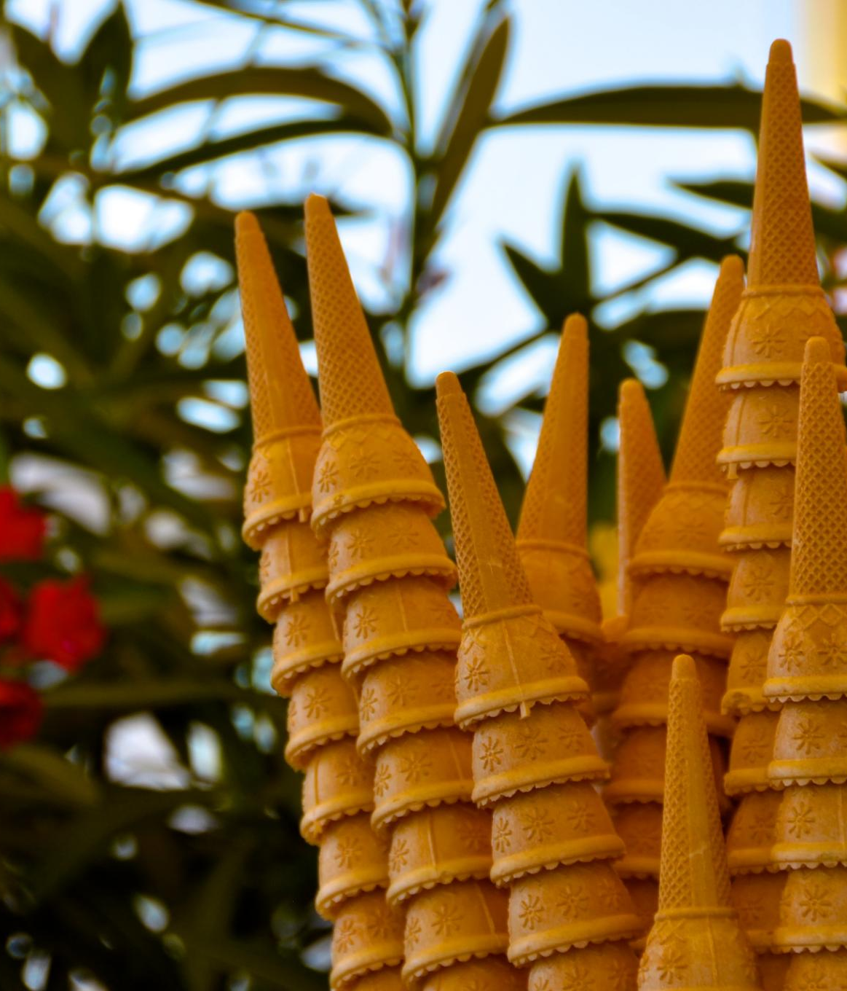
Step 6: Allow the Wax to Cool
Let the candle cool for several hours
Trim the wick to 1/4 inch
Notes:
After pouring the wax, allow the candle to cool for several hours until it has fully hardened. Once the candle has cooled, trim the wick to 1/4 inch using a wick trimmer.

Slide 8
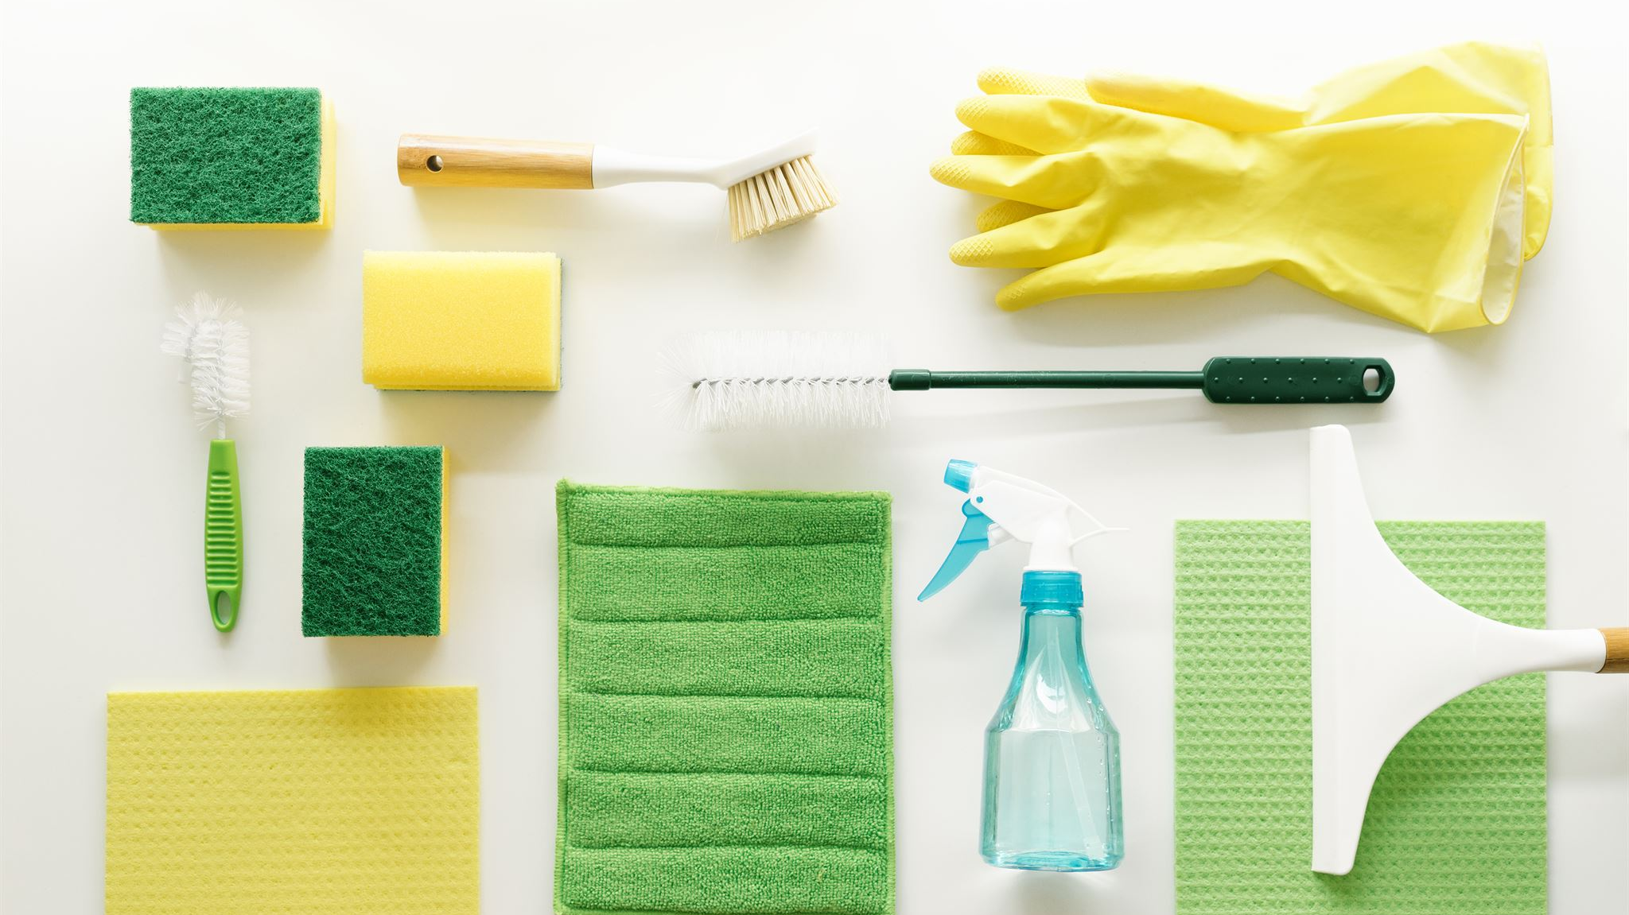
Step 7: Clean Up
Clean up any spills or messes
Store unused wax and supplies for future use
Notes:
Once you have finished making your candle, it's important to clean up any spills or messes. Store any unused wax and supplies in a safe place for future use.

Slide 9

Step 8: Enjoy Your Candle
Light your candle and enjoy!
Experiment with different fragrances and colors
Notes:
Congratulations, you have made your own candle! Light it up and enjoy the beautiful fragrance and warm glow. Don't be afraid to experiment with different fragrances and colors to create your own unique candles.

Slide 10
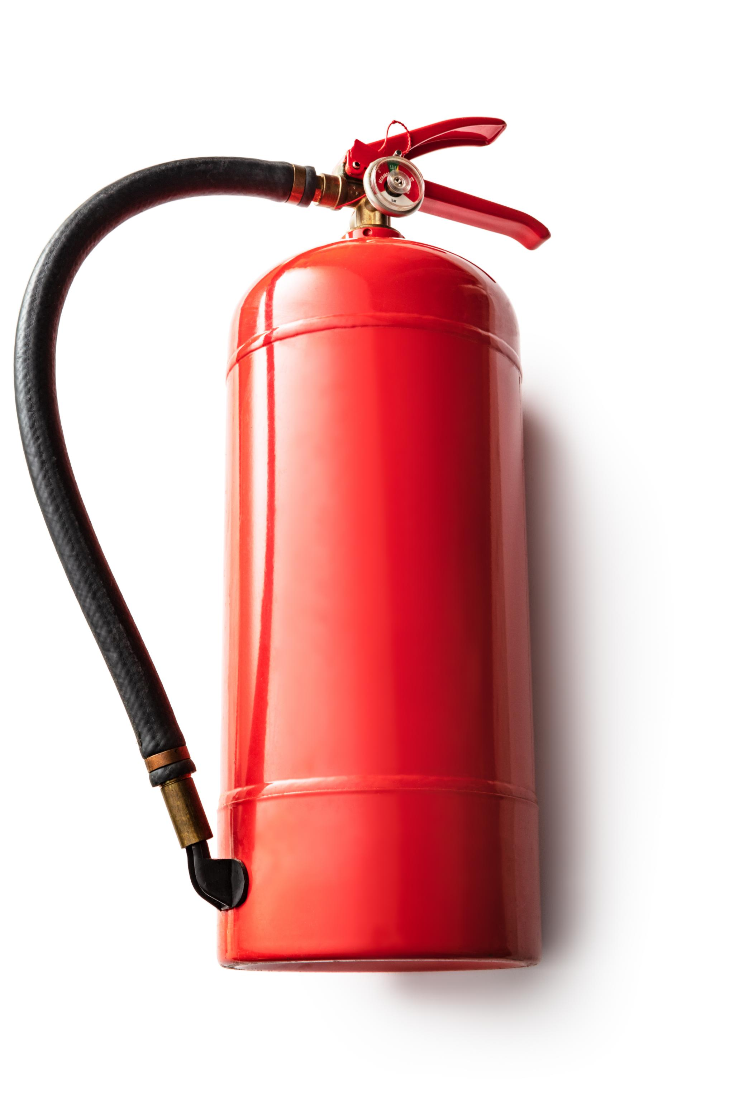
Candle Making Safety Tips
Never leave a burning candle unattended
Keep candles away from flammable objects
Trim wicks to 1/4 inch before each use
Notes:
Before you begin making candles, make sure you understand important safety tips. Always keep burning candles within sight, and never leave them unattended. Keep candles away from flammable objects, and trim wicks to 1/4 inch before each use.

